Slide 1
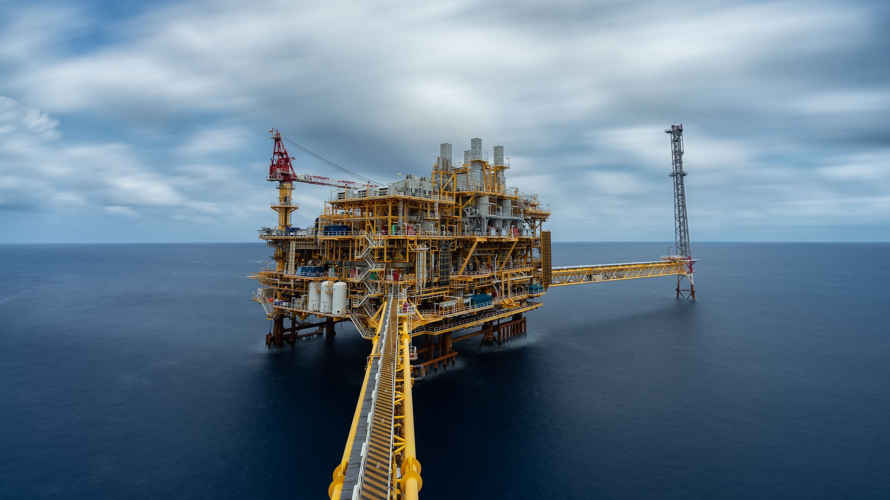
Gas Price Analysis
By: Elliott Thorley

Slide 2
Introduction
The price of gas has recently been very high, so I wanted to find out if it is due to the price of crude oil per barrel
Is the price of gas currently an outlier, or has this type of thing happened in the past?

Slide 3

The Data
Monthly Crude Oil Price-US Department of Energy
Date, Price of Crude Oil
January 1974 – December 2021
Weekly Price of Petroleum-US Department of Energy
Date, Price of 15 Various Types of Petroleum
August 1990 – March 2022

Slide 4
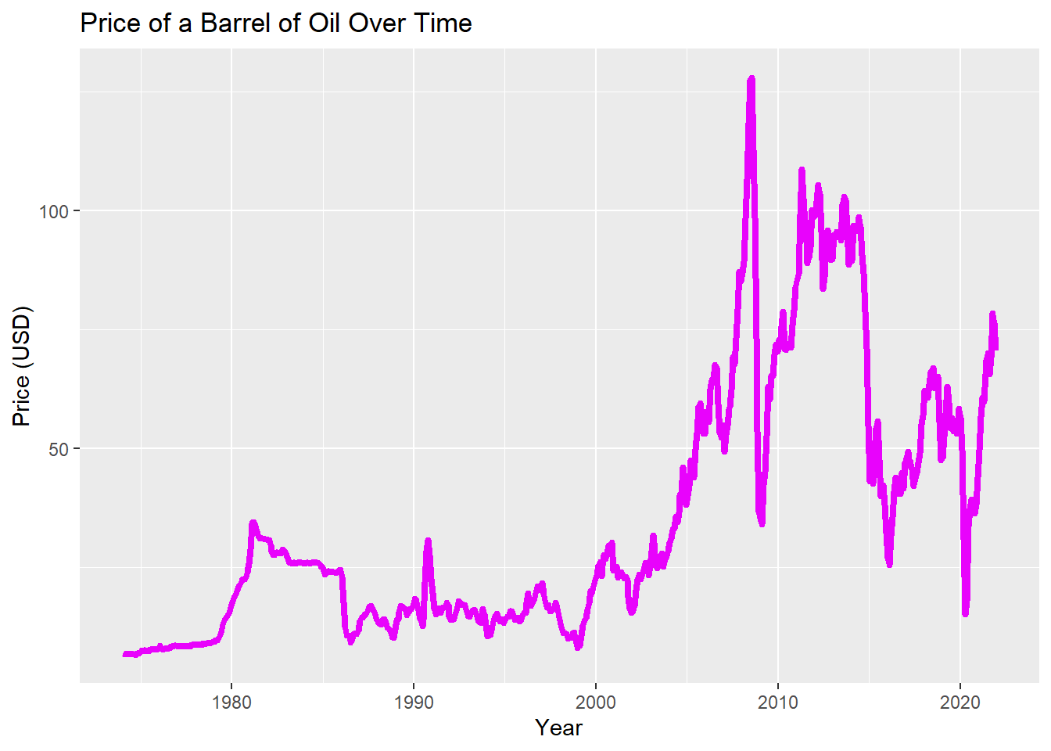
Exploratory Data Analysis
The first step towards answering the question was to visualize the price of crude oil over time
Points of interest

Slide 5
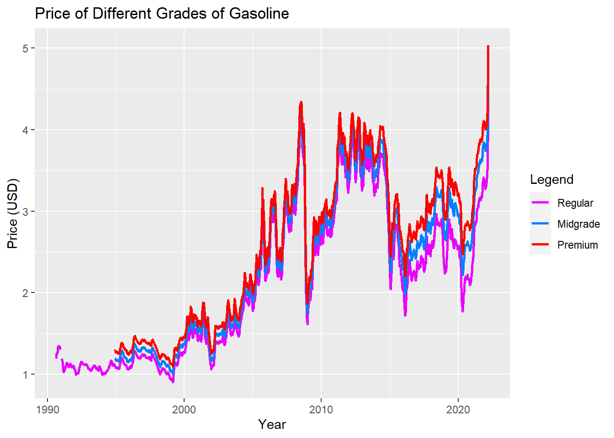
Exploratory Data Analysis Continued
Next, I wanted to visualize the 3 most common petroleum options
How does it compare to crude oil?

Slide 6
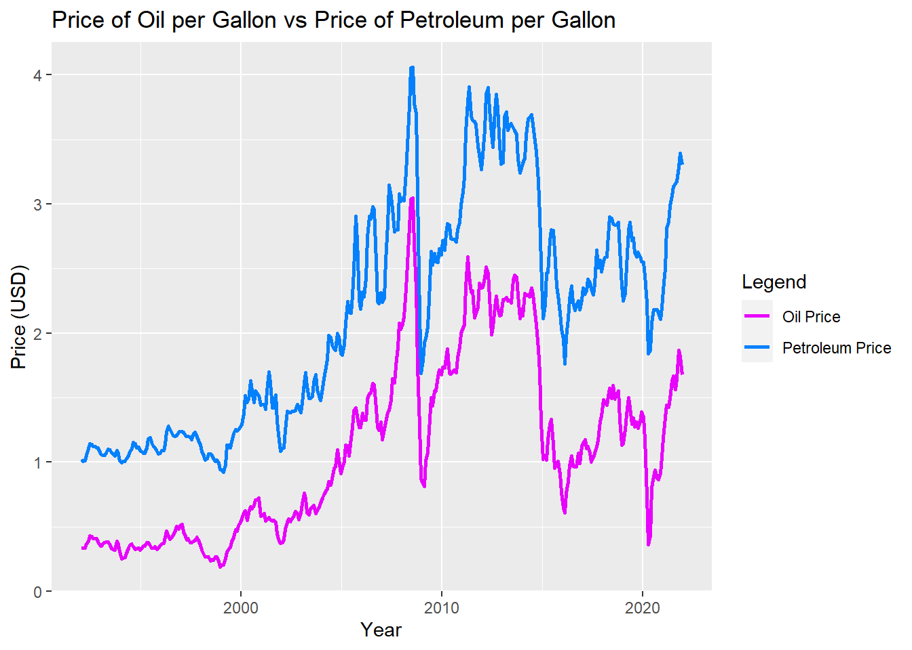
Exploratory Data Analysis Continued
Just how similar are they? Let's convert oil per barrel to oil per gallon, and plot it on the same graph as petroleum(regular)
Although similar there are some key differences

Slide 7
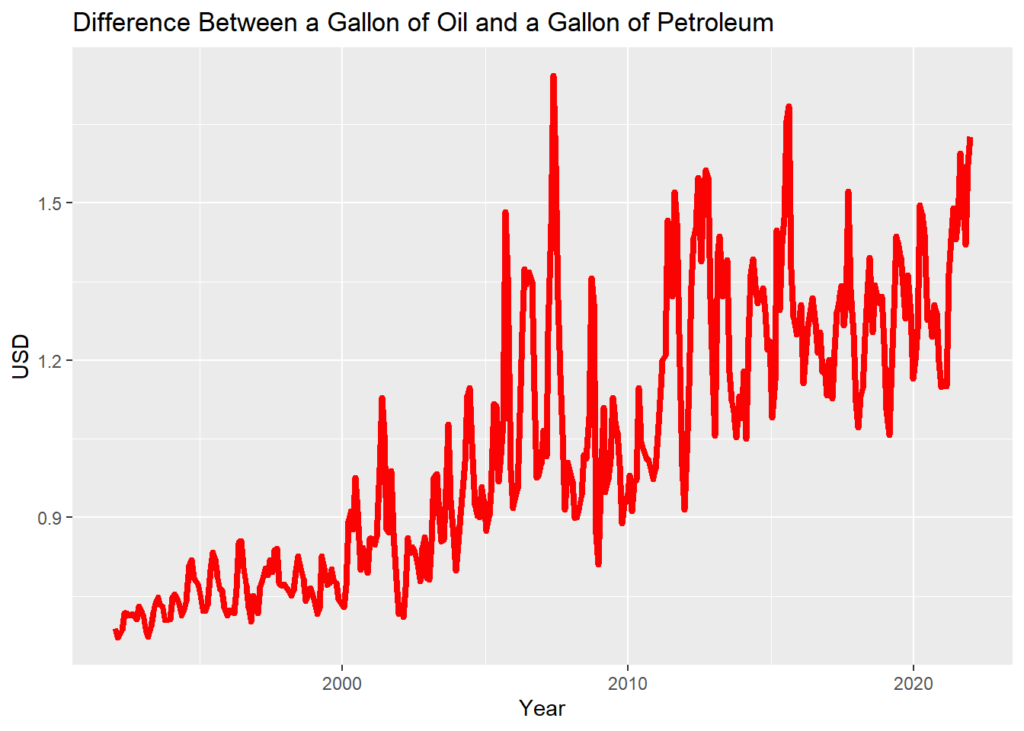
Exploratory Data Analysis Continued
Why are these two graphs not the same?
Figure out the difference between oil price and petroleum price to see the profit margin
What causes them to be increasing the profit margin?

Slide 8
Conclusion

